Slide 1
Discrete Mathematics and Its Application 7th edition, 2001
Kenneth H. Rosen

Slide 2
Welcome to Discrete Mathematics Spring 2018
Instructor: Niu Shao Zhang

Slide 3
§2.6 Matrices
Section Summary
Definition of a Matrix
Matrix Arithmetic
Transposes and Powers of Arithmetic
Zero-One matrices

Slide 4
§2.6 Matrices
Definition: A matrix is a rectangular array of objects (usually numbers).
An m×n (“m by n”) matrix has exactly m horizontal rows, and n vertical columns.
Plural of matrix = matrices (say MAY-trih-sees)
An n×n matrix is called a square matrix, whose order or rank is n.
a 3×2 matrix
Note: The singular form of “matrices” is “matrix,” not “MAY-trih-see”!

Slide 5
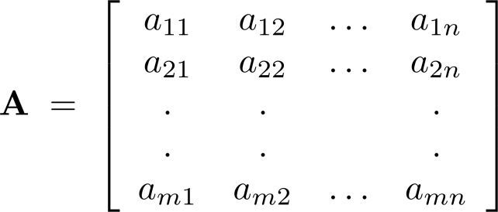

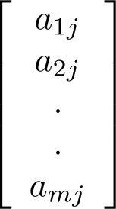
Notation
Let m and n be positive integers and let
The ith row of A is the 1 n matrix [a_{i1}, a_{i2},…,a_{in}]. The jth column of A is the m 1 matrix:
The (i,j)th element or entry of A is the
element a_{ij}. We can use A = [a_{ij} ] to denote the matrix with its (i,j)th element equal to a_{ij}.

Slide 6
Row and Column Order
The rows in a matrix are usually indexed 1 to m from top to bottom. The columns are usually indexed 1 to n from left to right. Elements are indexed by row, then column.

Slide 7
Applications of Matrices
Tons of applications, including:
Solving systems of linear equations
Computer Graphics, Image Processing
Models within many areas of Computational Science & Engineering
Quantum Mechanics, Quantum Computing
Many, many more…

Slide 8
Matrix Equality
Two matrices A and B are considered equal iff they have the same number of rows, the same number of columns, and all their corresponding elements are equal.

Slide 9
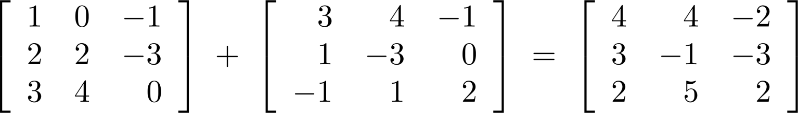
Matrix Arithmetic: Addition
Defintion: Let A = [a_{ij}] and B = [b_{ij}] be m n matrices. The sum of A and B, denoted by A + B, is the m n matrix that has a_{ij} + b_{ij} as its (i,j)th element. In other words, A + B = [a_{ij} + b_{ij}].
Example:
Note that matrices of different sizes can not be added.

Slide 10
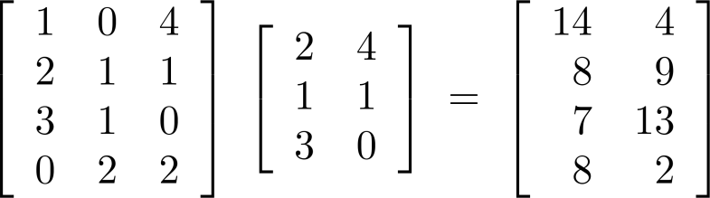
Matrix Multiplication
Definition: Let A be an m k matrix and B be a k n matrix. The product of A and B, denoted by AB, is the m n matrix that has its (i,j)th element equal to the sum of the products of the corresponding elments from the ith row of A and the jth column of B. In other words, if AB = [c_{ij}] then c_{ij} = a_{i1}b_{1j} + a_{i2}b_{2j} + … + a_{kj}b_{2j}.
Example:
The product of two matrices is undefined when the number of columns in the first matrix is not the same as the number of rows in the second.

Slide 11
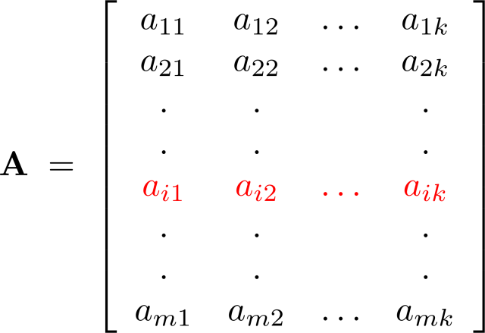
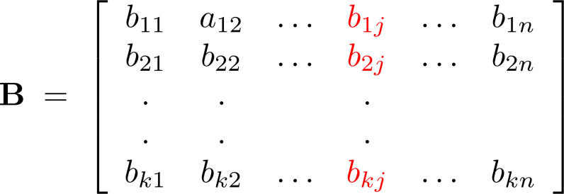
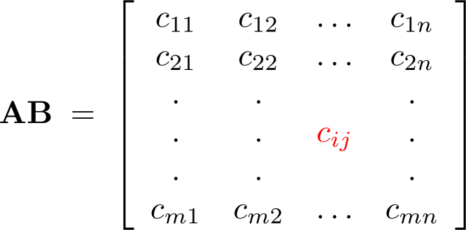
Illustration of Matrix Multiplication
The Product of A = [a_{ij}] and B = [b_{ij}]

Slide 12
Matrix Product Example
An example matrix multiplication to practice in class:

Slide 13
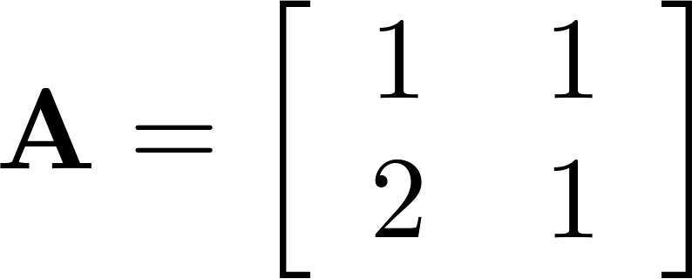
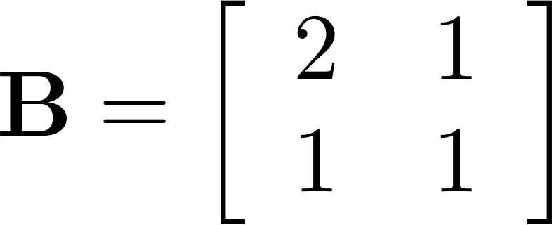
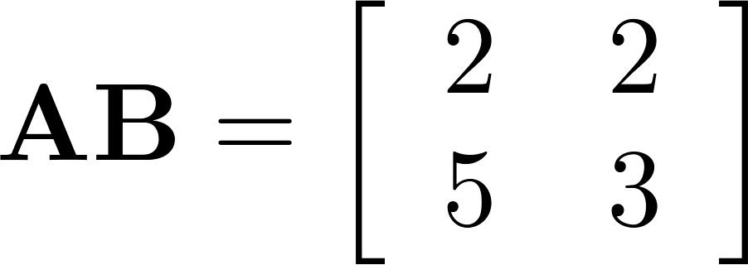
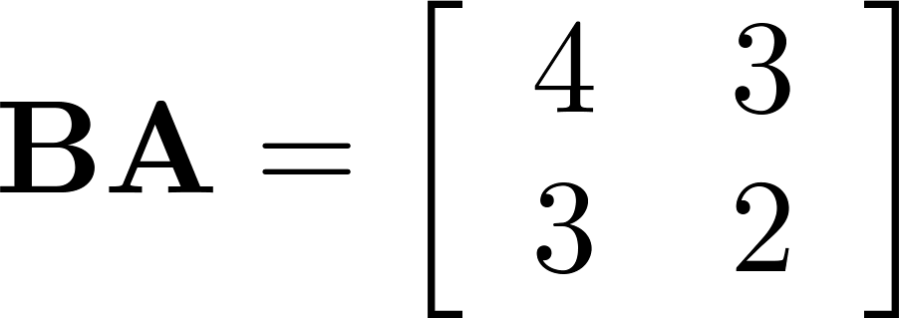
Matrix Multiplication is not Commutative
Example: Let
Does AB = BA?
Solution:
AB ≠ BA

Slide 14
Identity Matrices
The identity matrix of order n, I_{n}, is the rank-n square matrix with 1’s along the upper-left to lower-right diagonal, and 0’s everywhere else.
∀1≤i,j≤n
n
Kronecker Delta
n

Slide 15
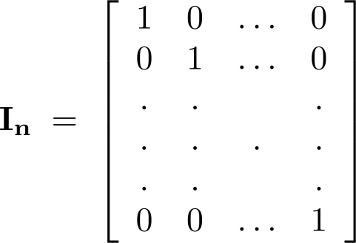
Identity Matrix and Powers of Matrices
Definition: The identity matrix of order n is the m n matrix I_{n} = [δ_{ij}], where δ_{ij} = 1 if i = j and δ_{ij} = 0 if i≠j.
AI_{n} = I_{m}A = A
when A is an m n matrix
Powers of square matrices can be defined. When A is an n × n matrix, we have:
A⁰ = I_{n} A^{r} = AAA∙∙∙A
r times

Slide 16
Powers of Matrices
If A is an n×n square matrix and p≥0, then:
A^{p} :≡ AAA···A (and A⁰ :≡ I_{n})
Example:
p times

Slide 17
Matrix Inverses
For some (but not all) square matrices A, there exists a unique multiplicative inverse A⁻¹ of A, a matrix such that A⁻¹A = I_{n}.
If the inverse exists, it is unique, and A⁻¹A = AA⁻¹.
We won’t go into the algorithms for matrix inversion...

Slide 18
Matrix Transposition
If A=[a_{ij}] is an m×n matrix, the transpose of A (often written A^{t} or A^{T}) is the n×m matrix given by A^{t} = B = [b_{ij}] = [a_{ji}] (1≤i≤n,1≤j≤m)
Flip across diagonal

Slide 19
Symmetric Matrices
A square matrix A is symmetric iff A=A^{T}. i.e., ∀i,j≤n: a_{ij} = a_{ji} .
Which of the below matrices is symmetric?

Slide 20
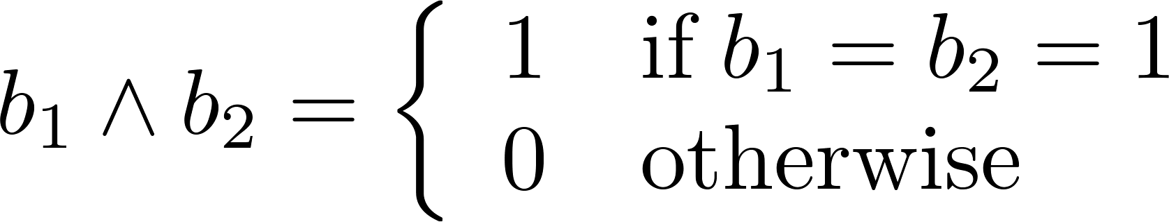
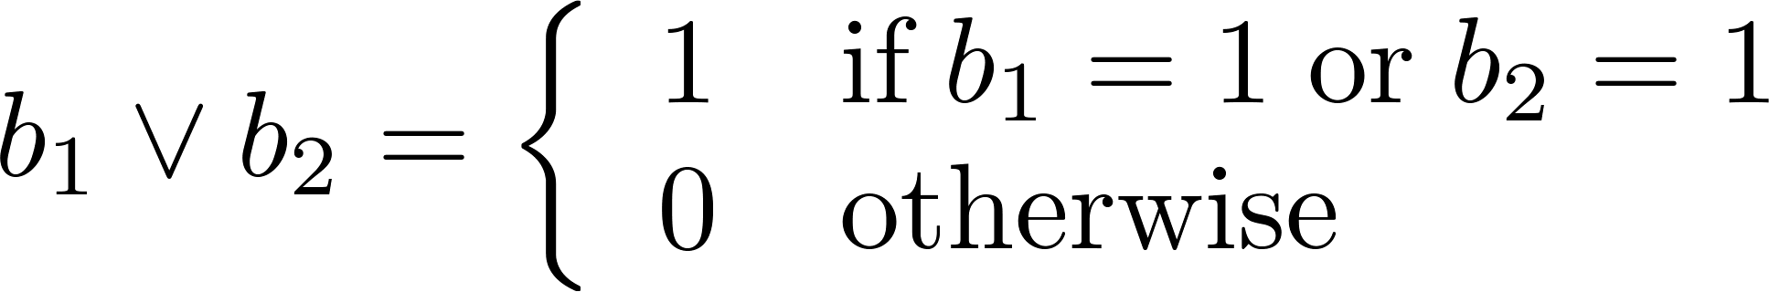
Zero-One Matrices
Definition: A matrix all of whose entries are either 0 or 1 is called a zero-one matrix. (These will be used in Chapters 9 and 10.)
Algorithms operating on discrete structures represented by zero-one matrices are based on Boolean arithmetic defined by the following Boolean operations:

Slide 21
Zero-One Matrices
Definition: Let A = [a_{ij}] and B = [b_{ij}] be an m × n zero-one matrices.
The join of A and B is the zero-one matrix with (i,j)th entry a_{ij} ∨ b_{ij}. The join of A and B is denoted by A ∨ B.
The meet of of A and B is the zero-one matrix with (i,j)th entry a_{ij} ∧ b_{ij}. The meet of A and B is denoted by A ∧ B.

Slide 22
Zero-One Matrices
The join of A, B (both m×n zero-one matrices):
A∨B :≡ [a_{ij}∨b_{ij}]
The meet of A, B:
A∧B :≡ [a_{ij}∧b_{ij}]
The 1’s in A join the 1’s in B to make up the 1’s in C.
Where the 1’s in A meet the 1’s in B, we find 1’s in C.

Slide 23
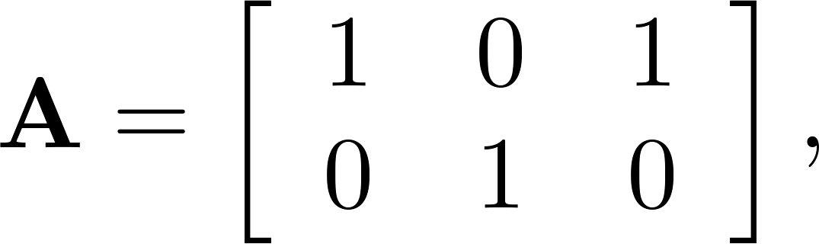
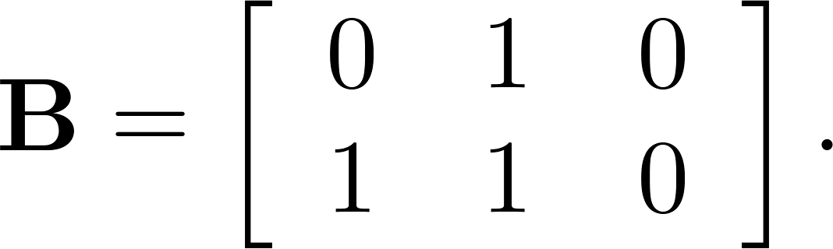
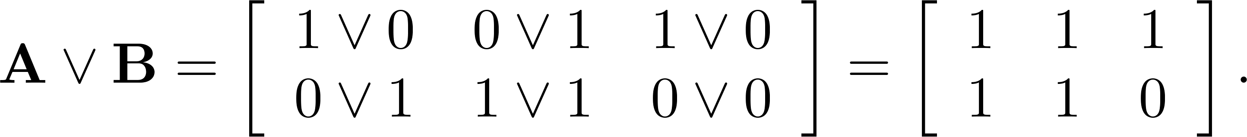
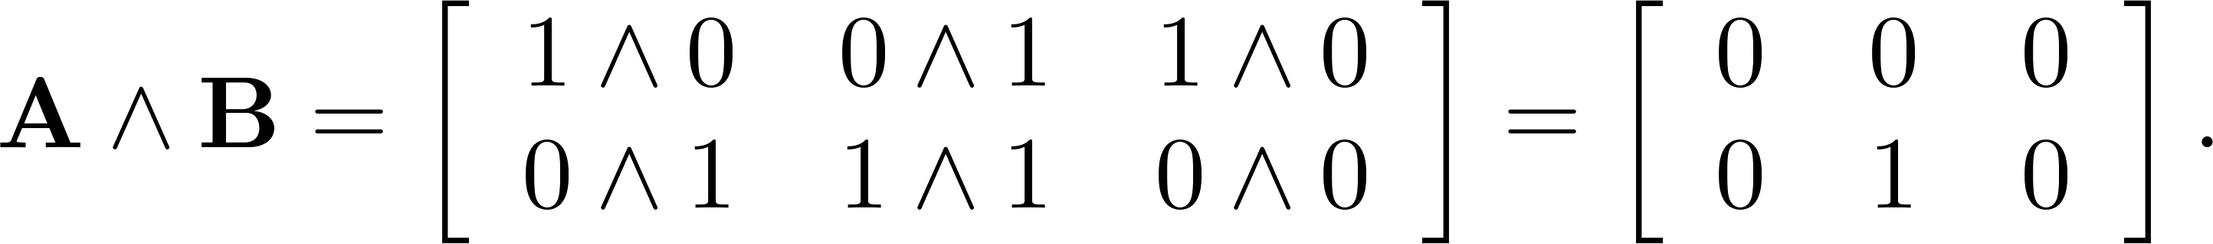
Joins and Meets of Zero-One Matrices
Example: Find the join and meet of the zero-one matrices
Solution: The join of A and B is
The meet of A and B is

Slide 24
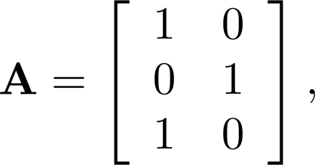
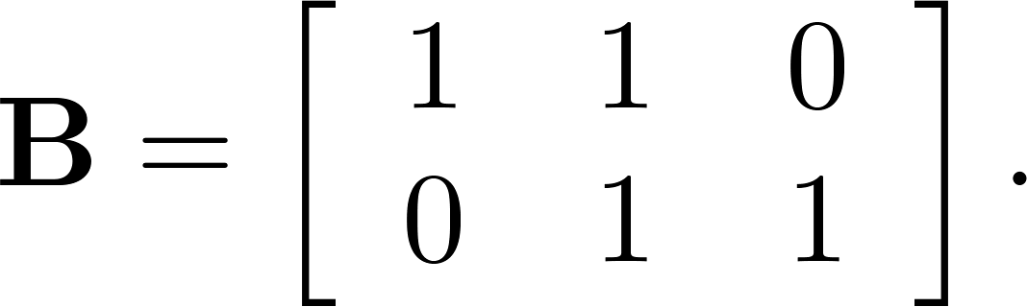
Boolean Product of Zero-One Matrices
Definition: Let A = [a_{ij}] be an m k zero-one matrix and B = [b_{ij}] be a k n zero-one matrix. The Boolean product of A and B, denoted by A ⊙ B, is the m n zero-one matrix with(i,j)th entry
c_{ij} = (a_{i1} ∧ b_{1j})∨ (a_{i2} ∧ b_{2j}) ∨ … ∨ (a_{ik} ∧ b_{kj}).
Example: Find the Boolean product of A and B, where
Continued on next slide →

Slide 25
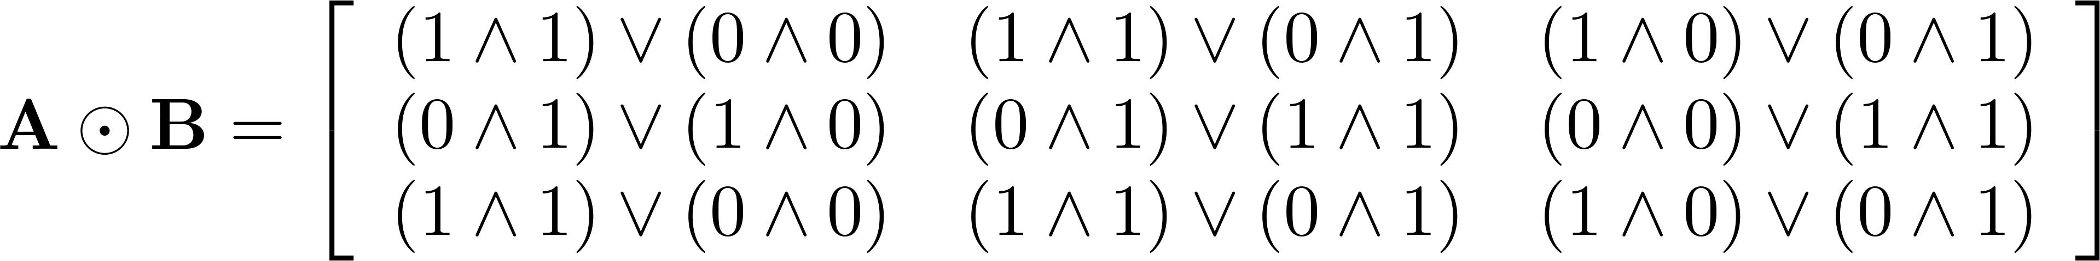
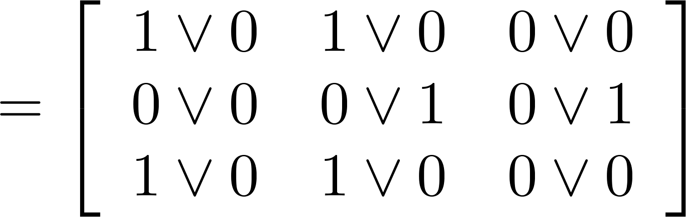
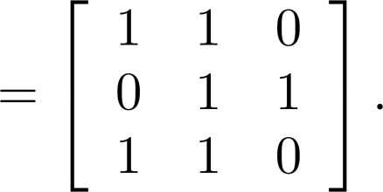
Boolean Product of Zero-One Matrices
Solution: The Boolean product A ⊙ B is given by

Slide 26
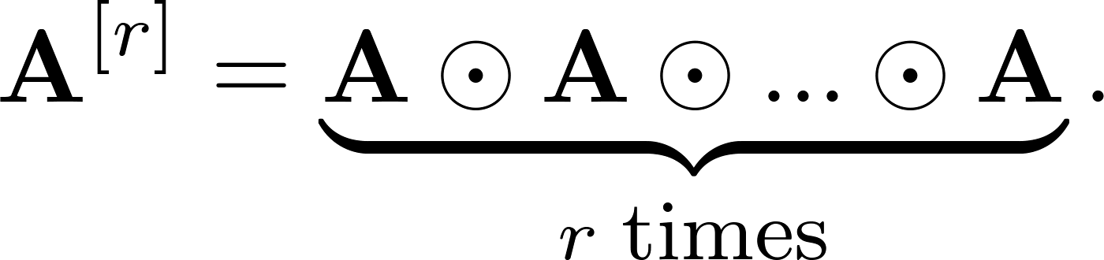
Boolean Powers of Zero-One Matrices
Definition: Let A be a square zero-one matrix and let r be a positive integer. The rth Boolean power of A is the Boolean product of r factors of A, denoted by A^{[r]} . Hence,
We define A^{[0]} to be I_{n}.
(The Boolean product is well defined because the Boolean product of matrices is associative.)

Slide 27
Boolean Powers
For a square zero-one matrix A, and any k≥0, the kth Boolean power of A is simply the Boolean product of k copies of A.
A^{[k]} :≡ A⊙A⊙…⊙A
A^{[0]} :≡ I_{n}
k times

Slide 28
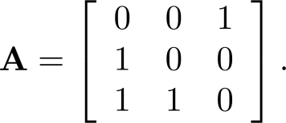
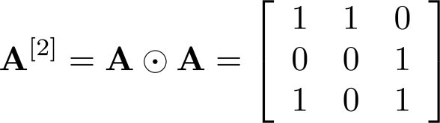
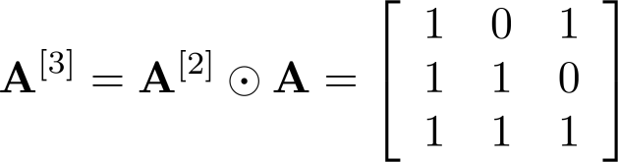
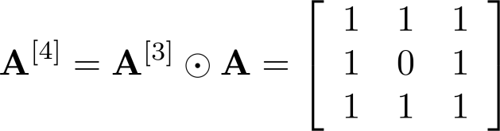
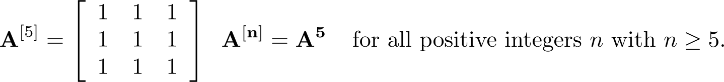
Boolean Powers of Zero-One Matrices
Example: Let
Find A^{n} for all positive integers n.
Solution:

Slide 29
Basic properties of the Boolean matrix
If A, B, and C are Boolean matrices of compatible sizes, then

Slide 30
Homework
§2.6
4（b）, 20, 28, 32

